Slide 1


Alzheimer Detector
Team Members:
Hanan Almaktoum
Shahad Qadi
Shahad Alshahrani
Raghad Alghamdi
Supervised By : Dr . Nassima Aleb
Shahad Qadi

Slide 2
Table of Content
1- Introduction
2- System Design
3- Data Preprocessing
3.1- Features Extraction
3.2- Features Selection
4- Training and Testing
5- implementation
6- Demo
Shahad

Slide 3
Introduction
Shahad

Slide 4
2- System Design
Shahad

Slide 5
2- System Design
Context Model
Interaction Model
Behavioral Model
Shahad

Slide 6
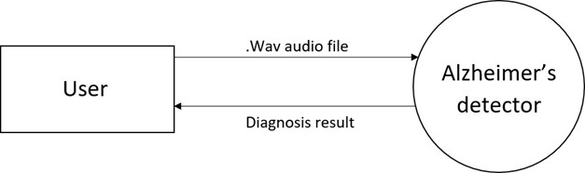
Context Model
Shahad

Slide 7
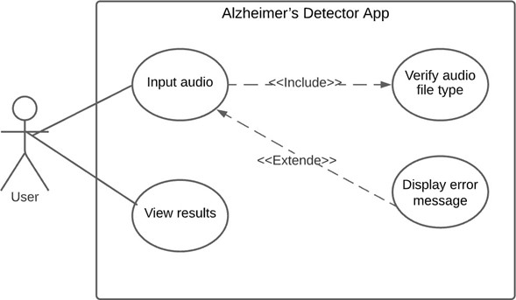
Interaction Model
Shahad

Slide 8
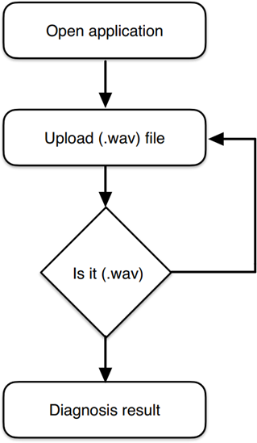
Behavioral Model
Shahad

Slide 9
3- Data Preprocessing
Hanan Almaktoum & Raghad Alghamdi

Slide 10

3.1- Features Extraction
Hanan

Slide 11


3.2 Features Selection
Raghad

Slide 12
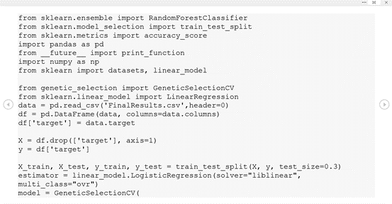
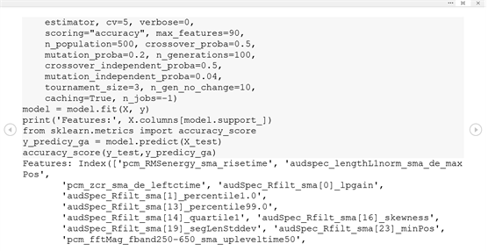
Raghad

Slide 13
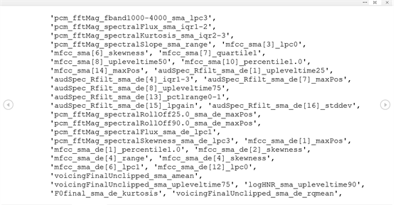
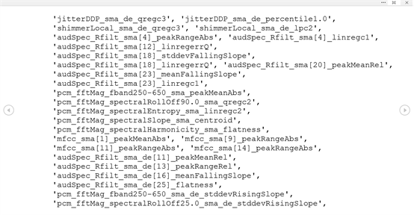
Raghad

Slide 14
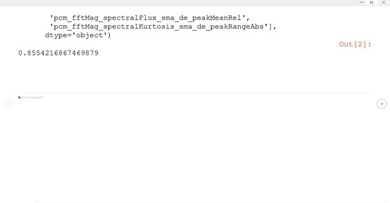
Accuracy Result : 0.8554216867469879
Raghad

Slide 15
4- Training and Testing
Shahad Ahshahrani

Slide 16

4- Training and Testing
shahad

Slide 17
5- Impelementation

Slide 18
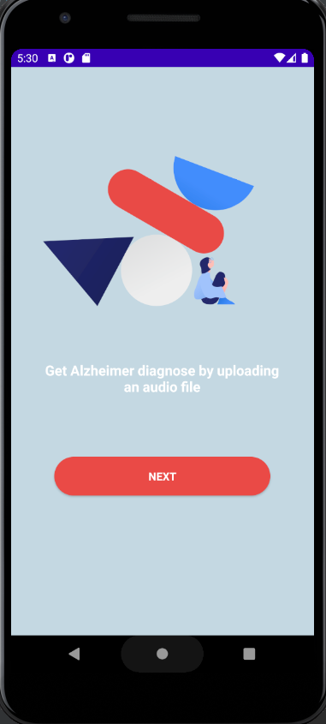

Android & IOS Application

Slide 19
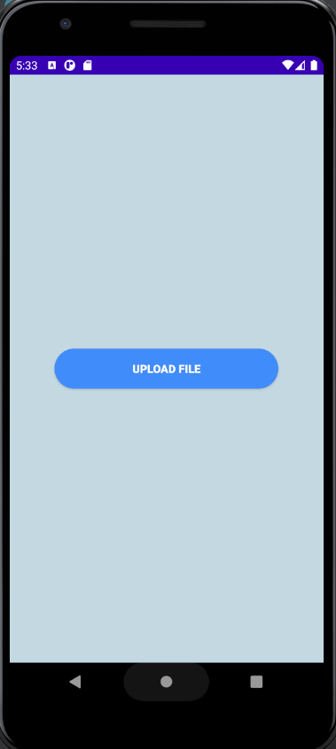

Android & IOS Application design

Slide 20
6 - Demo

Slide 21
Q & A

Slide 22
Thank You
Team Member :
Shahad Alshahrani
Raghad Alghamdi
Hanan Almaktoum
Shahad Qadi
Supervised By : Dr. Nassiam Aleb

